Slide 1
Phase Rule
It was first presented by Gibbs in 1875.
It is used to determine the number of degrees of freedom (F) for a system. Sometimes called: “the variance of the system”.
It is very useful to understand the effect of intensive thermodynamic properties, such as temperature, pressure, or concentration, on the equilibrium between phases.

Slide 2
Phase Rule
The Phase Rule describes the possible number of degrees of freedom in a (closed) system at equilibrium, in terms of the number of phases and the number of chemical constituents in the system.
The rule is:
F = C – P + 2
Where:
F= degrees of freedom
C = number of chemical constituents/components
P = number of phases

Slide 3
Degrees of Freedom [F]:
Degrees of Freedom [F] is the number of independent intensive variables (i.e. those that are independent of the quantity of material present) that need to be specified to fully determine the state of the system.
Typical such variables might be temperature, pressure, or concentration.
Notes:
but not influenced by gravity, or electrical or magnetic forces or by surface action

Slide 4
Phase:
A phase is defined as any homogeneous and physically distinct part of a system having all physical and chemical properties the same throughout the system.
A system may consist of one phase or more than one phase e.g.
A system containing only liquid water is one-phase system
A system containing liquid water and water vapour (gas) is a two phase system
A system containing liquid water, water vapour and solid ice is a three phase system.

Slide 5
Chemical constituent / Component
The term component is defined as the least number of chemical constituents in terms of which the composition of every phase can be expressed by means of a chemical equation. e.g.
Water system has three phases, ice, water and water vapour and the composition of all these phases is expressed in terms of one chemical individual water. Thus water system has one component only.
Similarly Sulphur system has four phases: rhombic sulphur, monoclinic sulphur, liquid sulphur and sulphur vapour and the composition of all these phases is expressed by one chemical individual sulphur. Therefore Sulphur system is one component system.

Slide 6
F = C – P + 2
Phase rule example:
The state of a pure homogeneous fluid is fixed whenever two intensive thermodynamic properties are set at definite values.
In contrast, when two phases are in equilibrium, the state of the system is fixed when only a single property is specified.
For example, a mixture of steam and liquid water in equilibrium at 101.325 kPa can exist only at 373.15 K (100°C).

Slide 7
F = C – P + 2
Phase rule example:
A system with one component and one phase (a balloon full of carbon dioxide, perhaps) has two degrees of freedom: temperature and pressure, say, can be varied independently.
If you have two phases -- liquid and vapour for instance -- you lose a degree of freedom, and there is only one possible pressure for each temperature.
Add yet one more phase -- ice, water and water vapour in a sealed flask -- and you have a "triple point" with fixed temperature and pressure.
Notes:
but not influenced by gravity, or electrical or magnetic forces or by surface action

Slide 8
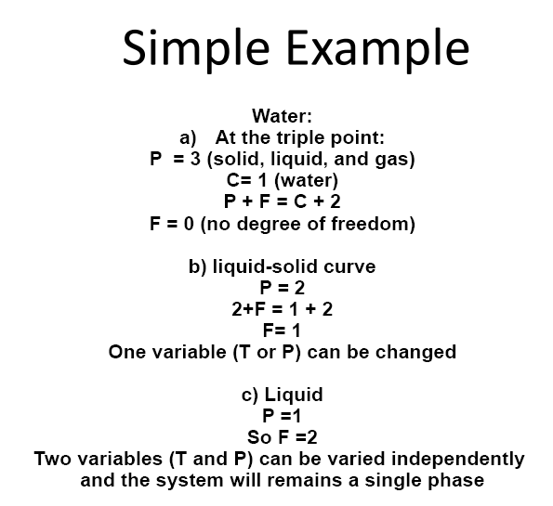

Slide 9
The Phase Diagram
Phase diagram: shows the regions of pressure and temperature at which its various phases are thermodynamically stable.
Phase boundary: a boundary between regions, shows the values of P and T at which two phases coexist in equilibrium.

Slide 10
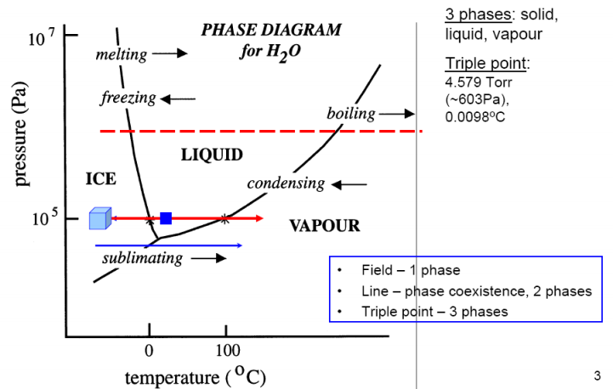

Slide 11
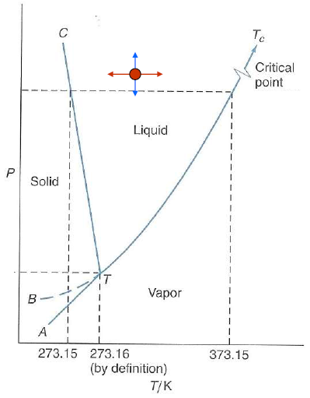
The Water System
How many components do you have?
We have only one component which is H₂O.
In the one-phase regions, one can vary either
The temperature, or the pressure, or both
(within limits) without crossing a phase line.
We say that in these regions:
f = c – p + 2 = 1 – 1 + 2
= 2 degrees of freedom.
Notes:
Critical point: beyond this a gas can not be liquefied
Melting point; Solid and liquid can co-exist
Triple point: Solid, Liquid and gas can co-exist.

Slide 12
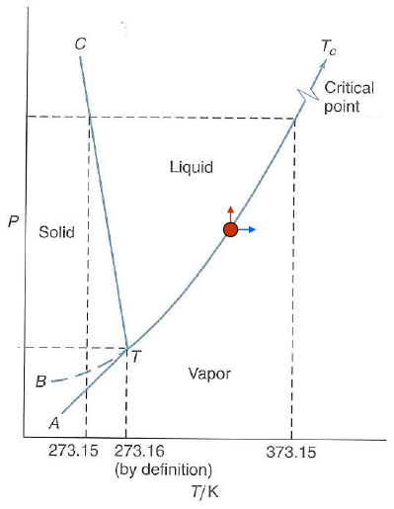
Along a phase line we have two phases
in equilibrium with each other,
so on a phase line the number of phases
is 2.
If we want to stay on a phase line,
we can't change the temperature and
pressure independently.
Therefore, along a phase line:
f = c – p + 2 = 1 – 2 + 2
= 1 degree of freedom.

Slide 13
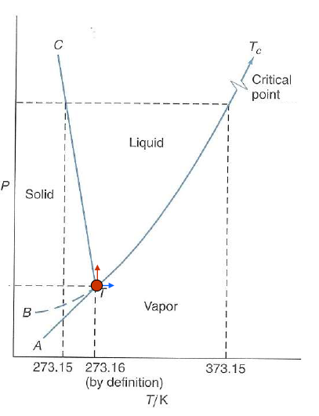
At the triple point there are three phases
in equilibrium, but there is only one
point on the diagram where we can
have three phases in equilibrium
with each other.
Therefore, at the triple point:
f = c – p + 2 = 1 – 3 + 2
= 0 degrees of freedom.

Slide 14
Latent Heat Of Pure Substances
When a pure substance is liquefied from the solid state or vaporized from the liquid at constant pressure, no change in temperature occurs; however, the process requires the transfer of a finite amount of heat to the substance.
These heat effects are called the latent heat of fusion and the latent heat of vaporization.
Latent heat of fusion: The amount of heat required to melt the substance of unit mass from solid to liquid.
Latent heat of vaporization: The amount of heat required by the unit mass of substance to vaporize from liquid to gaseous state
Notes:
latent heat of fusion amount of heat required to melt the substance of unit mass from solid to liquid
latent heat of vaporization The amount of heat required by the unit mass of substance to vaporize from liquid to gaseous state

Slide 15
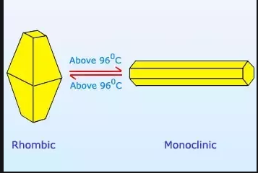
Heat of Transition (or heat of transformation)
The amount of heat that must be absorbed or given up by a substance when it undergoes an equilibrium constant-pressure and constant-temperature transition from one phase to another.
For example, the heat absorbed when rhombic crystalline sulfur changes to the monoclinic structure at 368.15 K (95°C) and 1 bar is 360 J for each g atom.
Notes:
latent heat of fusion amount of heat required to melt the substance of unit mass from solid to liquid
latent heat of vaporization The amount of heat required by the unit mass of substance to vaporize from liquid to gaseous state

Slide 16
The characteristic feature of all these processes is the coexistence of two phases.
According to the phase rule, a two-phase system consisting of a single species is univariant, and its intensive state is determined by the specification of just one intensive property.

Slide 17

Thus the latent heat accompanying a phase change is a function of temperature only, and is related to other system properties by an exact thermodynamic equation:
ΔH= Latent Heat
ΔV= Volume change accompanying the phase change
P^{sat} = saturation pressure

